Slide 1
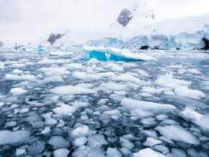
Why are you worried about the climate change?
More difficult to grow food for farmers in Germany;
In Sweden we have noticed that the winters are getting hotter and hotter;
Ice melting what we are worried about because of the water rasing, worse costal storm, when the ice melts, polar bears no longer know where to live;
When the Jetstream’s get slower and the air gets warmer.

Slide 2
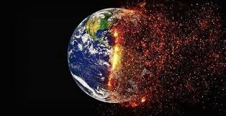
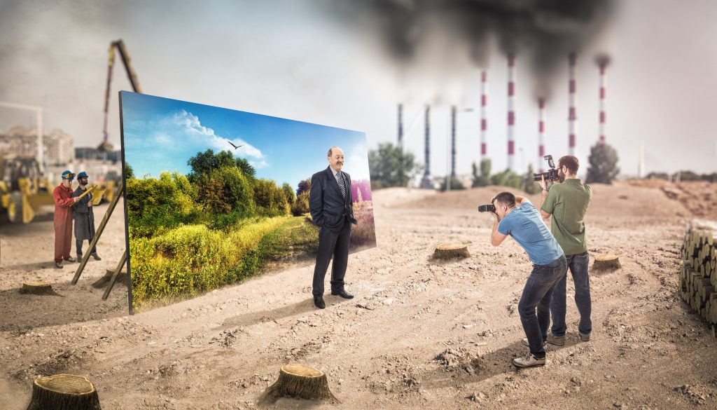
How does it change in your life?
It changed everything in people's lifestyle. A more harmful climate to health both from the point of view of temperatures and for what concerns the toxic materials dissolved in the air that have caused climate change and consequently a deterioration in the quality of the air we breathe and also, in the rest of natural phenomena which should be clean, like earth, rain setting off a cycle of infection In fact, from the earth and from the rain we arrive at crops and farms.

